Slide 1
Model-Agnostic Counterfactual Reasoning for Eliminating Popularity Bias in Recommender System
ADVISOR: JIA-LING KOH
PRESENTER: CHENG-WEI CHEN
SOURCE: KDD’21
DATE: 2022/1/26

Slide 2
Outline
Introduction
Method
Experiment
Conclusion

Slide 3
Outline
Introduction
Problem
Previous Work
Target

Slide 4
Problem
Probability of next items user will interacts with
User u
Output
Item i
Input
Previous n items records

Slide 5
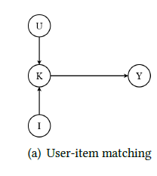
Previous work
U: user
I: item
K: matching features
Y: ranking score
Recommending popular items more frequently can achieve lower loss
=> popular items are recommended more and become even more popular.
Notes:
Y: ranking score (e.g., the probability of interaction)

Slide 6
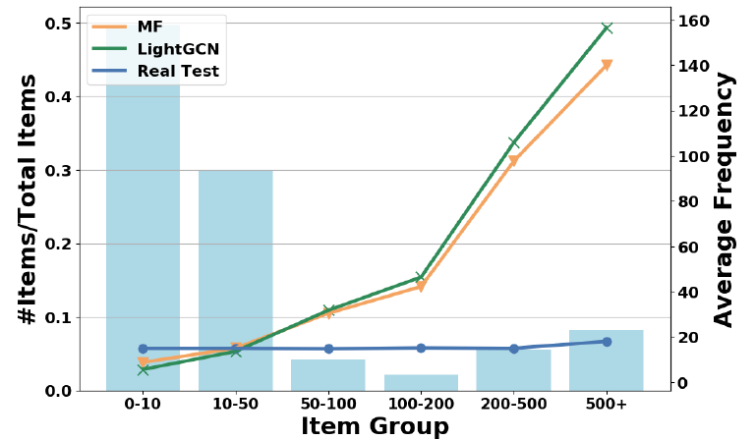
Bar
graph
Line chart
Item popularity

Slide 7
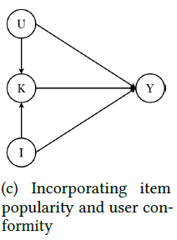
Target
In our view, three main factors affect the probability of an interaction:
User-item matching
Item popularity
User conformity (Numbers of user interactions)

Slide 8
Outline
Introduction
Method
Experiment
Conclusion

Slide 9
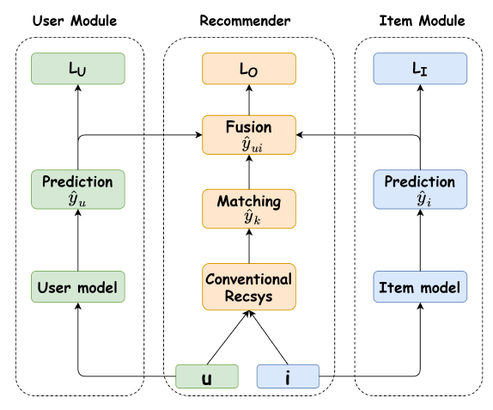
Architecture
Ranking score from
exist recommender
User conformity
Item popularity
populariy bias?
U -> Y
K -> Y
I -> Y

Slide 10
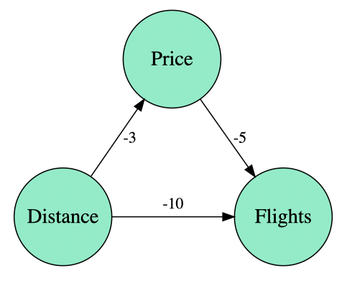
Causal graph (take airplane company as example)
Natural direct effect(NDE):
(Distance -> Flights)
Total Indirect effect(TIE):
(Distance -> Price -> Flights)
Total effect (TE) = TIE +NDE
Notes:
Distance is the distance from the city bringing most of their clients
Price is the monthly mean price
Flights is the monthly mean number of flights.
直接影響（距離->航班）：客戶對距離的負面看法。
間接影響（距離->價格->航班）：距離增加，迫使公司降低價格並產生航班增量。

Slide 11
Causal graph (take airplane company as example)
Price <= -3 Distance + Random_1
Flights <= -10 Distance + -5 Price + Random_2
= (-10 + (-5)(-3) ) Distance + Random_3
= 5 Distance + Random_3
Notes:
Distance is the distance from the city bringing most of their clients
Price is the monthly mean price
Flights is the monthly mean number of flights.

Slide 12
Causal graph
𝑌 (.) means the value function of Y
Ex:
U -> Y
𝐾u𝑖 = 𝐾(𝑈 = u, 𝐼 = 𝑖)
NDE
I -> Y
K -> Y
TIE

Slide 13
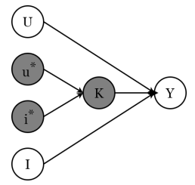
Causal graph - NDE
𝑌 (.) means the value function of Y
Ex:
𝐾u𝑖 = 𝐾(𝑈 = u, 𝐼 = 𝑖)
𝑈 = 𝑢∗, 𝐼 = 𝑖∗ refers to a the situation where the value of
𝑈,𝐼 is muted from the reality, typically set the value as null
Notes:
𝐼 = 𝑖∗ , 𝑈 = 𝑢 ∗refers to a the situation where the value of 𝐼 is muted from the reality, typically set the value as null

Slide 14
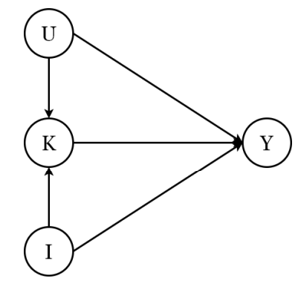
Causal graph - TE, TIE
𝑌 (.) means the value function of Y
Ex:
User conformity &
Popularity bias

Slide 15
Counterfactual Inference
Influence from
item popularity
Control popularity bias
Reflects what item 𝑖 matches the preference of user 𝑢
Influence from
user conformity

Slide 16
Loss function

Slide 17
Outline
Introduction
Method
Experiment
Conclusion

Slide 18
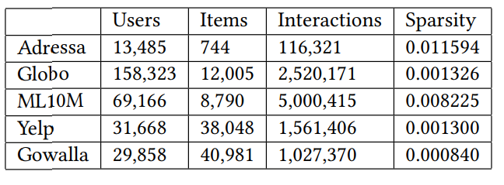
Dataset
Notes:
90% sparse – meaning that 90% of its cells are either not filled with data or are zeros.
Adressa, Globo 新聞推薦
Yelp 商品評論
Gowalla 社交網路服務，可記錄移動位置點

Slide 19
Experiment (MACR outperform)
V
V
V
V
Notes:
Expo 分別估計用戶偏好和曝光的機率模型。
CausE separate the training set into debiased and biased
BS 加 biased
Reg 是一種基於正則化的方法，它有意降低短尾項目的權重，覆蓋更多項目，從而改進長尾推薦
IPW分析數據的主要問題是群體不平衡。這可能會在組之間產生有偏見，所以做逆概率加權
Dice Disentangling User Interest and Conformity，此篇baseline (loss不同、沒有-c的那一項)

Slide 20
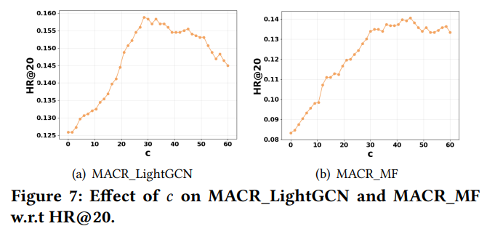
Experiment (Effect of c) [p15]

Slide 21
Experiment (Effect of user & item branch) [p16]

Slide 22
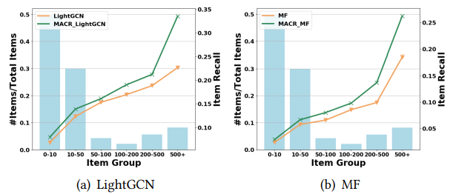
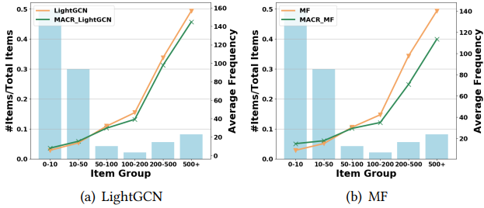
Experiment (Effect of popularity bias)
Average item recall in different item groups on Adressa
Frequency of different item groups recommended[p6]

Slide 23
Outline
Introduction
Method
Experiment
Conclusion

Slide 24
Conclusion
Presenting a causal view of the popularity bias in recommender systems and formulating a causal graph for recommendation.
Proposing MACR framework trains the recommender model according to the causal graph and eliminate popularity bias of recommendation.
Evaluating on five real-world recommendation datasets to demonstrate the effectiveness and rationality of MACR

